Slide 1

DevOps & Cloud Infrastructure SEIS 665 Week 13
Jason Baker
Adjunct Instructor
Graduate Programs in Software
University of St. Thomas
St. Paul, MN

Slide 2
Agenda
Data center architecture
Major data center components
Data center efficiency
Data center tiers
Future architectures
Final

Slide 3
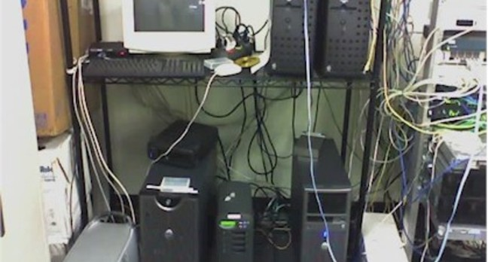
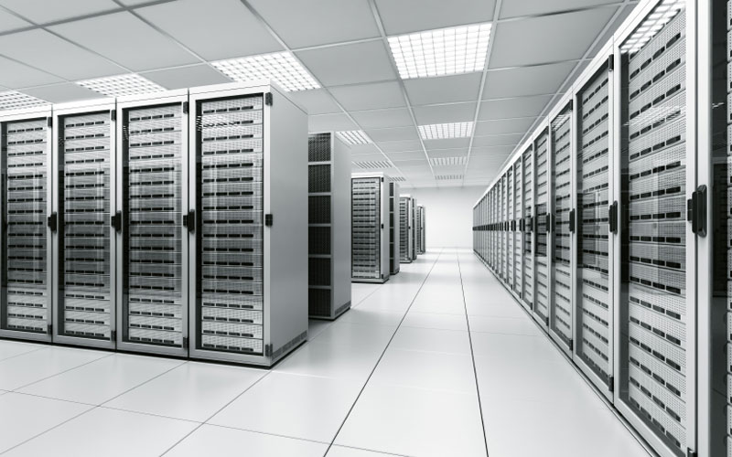
What is a data center?
Specialized physical location designed to support computing infrastructure.
NOT THIS
THIS

Slide 4
Key Attributes
Physical enclosure for greater security.
High grade electrical and heating, venting & cooling (HVAC) systems for greater reliability.
Easy access to mechanical and computing systems for greater maintainability.

Slide 5
Overall Architecture
DC consists of both internal and external assets.
It’s not just a building, it’s a property.
Internal (facility)
Server room: 50%
Support equipment: 40%
Miscellaneous: 10%
Equipment storage
Setup bench
NOC
Employee workspace
External
Generators, cooling towers, power transformers, parking lot

Slide 6
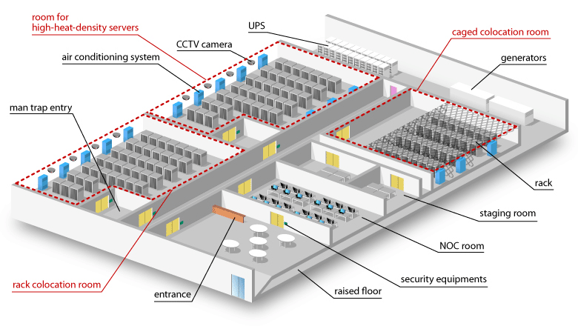

Slide 7
DC Key Components
Power system
Climate control system
Network
Security system
Fire detection and suppression
Server room
Network Operations Center (NOC)

Slide 8
Power System
Power system is critical for IT system reliability.
3 basic parts:
Distribution: power from utility providers and generators must be distributed to IT equipment.
Generation: most DCs have the ability to generate their own power using generators (gensets).
Switching: DC operator must be able to control flow of power in facility.

Slide 9
Power Distribution
Power utilities supply power to multiple sub-stations forming separate geographical grids.
One or more feeds from substations connect to transformers at data center facility.
Power is connected through switching infrastructure at facility to Power Distribution Units (PDUs) in server room.
PDUs provide power circuits to individual equipment racks.

Slide 10
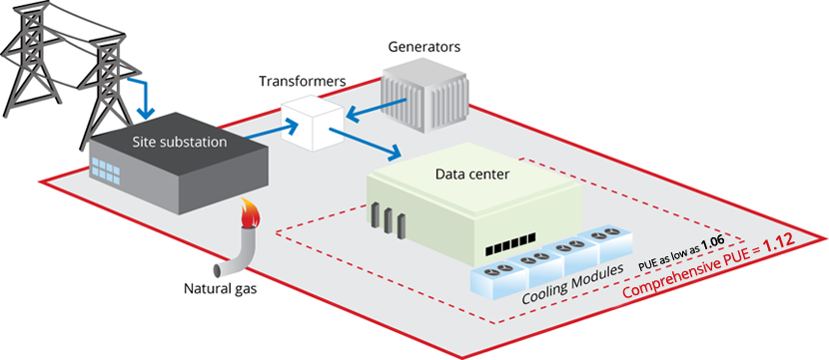
Google data center

Slide 11
Power Generation
DC operators consider self-generated power to be the most reliable power in facility and primary power source.
Utility power is used even though it is less reliable because it’s cheaper.
Generators are configured in an N+1 configuration.
N+1 means that one additional generator is installed beyond what is needed to support the DC (failover for redundancy/ maintenance).
Generators usually run on diesel fuel or natural gas.
Special mix and heating bed required for cold climates
Onsite storage tank required (thousands of gallons)
Emergency response refueling contract

Slide 12
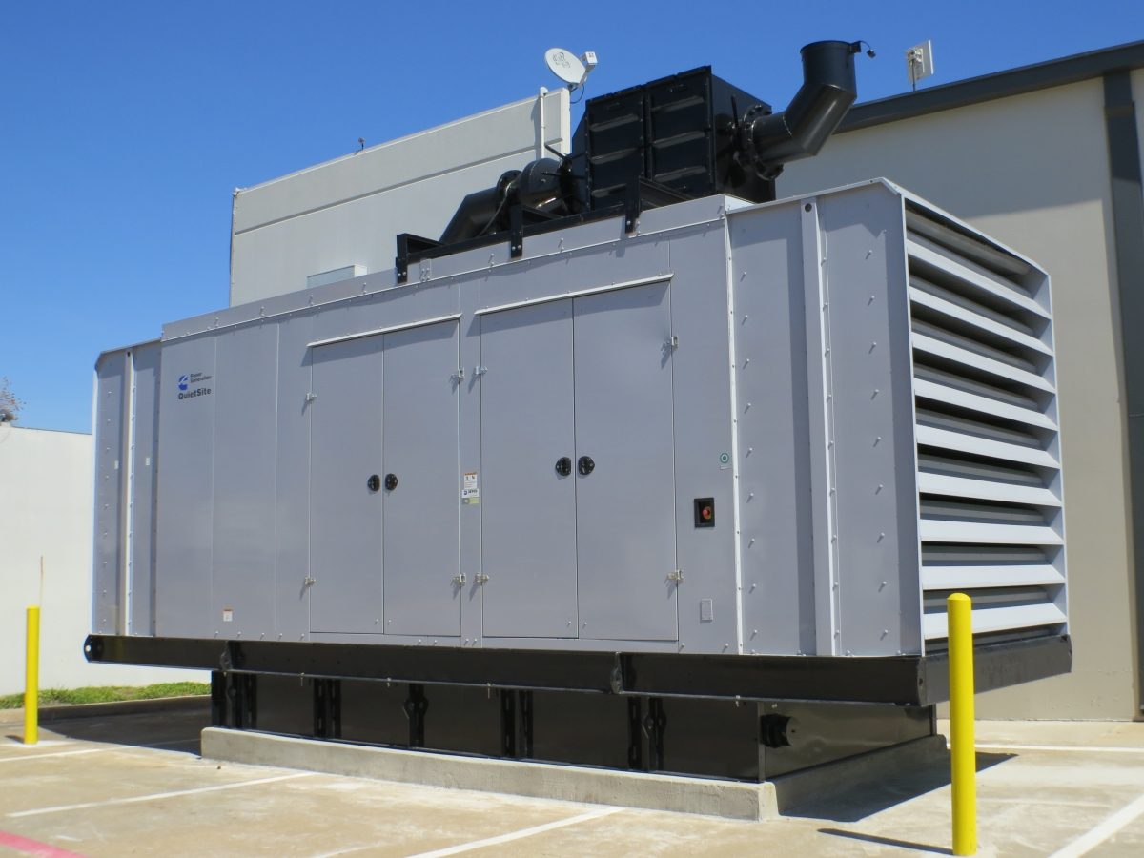
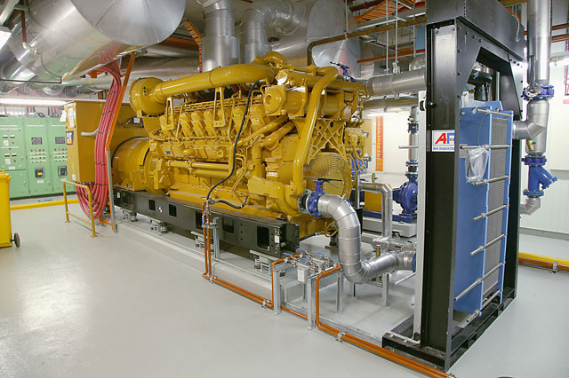
External generator sitting on fuel
bed.
Internal generator – lower risk of weather-related issues.

Slide 13
Power Switching
Data centers receive power from multiple sources and need a way to switch from one source to another.
Automatic Transfer Switch (ATS) provides power switching
Problem: switching power isn’t instantaneous
Generators need time to start up (5-10 seconds)
Power phases need time to synchronize (3-phase power)
Solution: ride time power to bridge gap in time between utility failure and self-generated power.

Slide 14
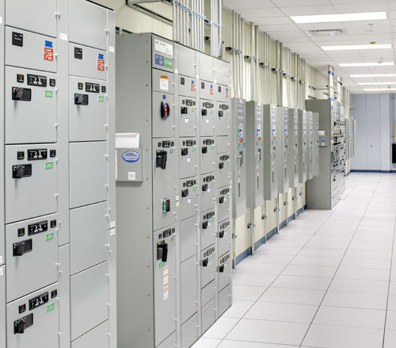
Automatic Transfer Switches

Slide 15
Uninterruptable Power Supply (UPS)
A UPS provides ride time power in a data center facility.
Two key types:
Batteries (traditional)
Key benefit: provides 5-10 minutes of ride time power
Batteries are wired in series and strings go bad over time requiring quarterly audits and maintenance
More cooling and space required to house
Environmentally unfriendly
Flywheels
Cabinet containing steel or carbon fiber wheel spinning at a high rate, usually in a vacuum on magnetic bearings
Inertia of spinning wheel generates 8-10 seconds of power
Very low maintenance
Low physical space and cooling requirements
Expensive

Slide 16
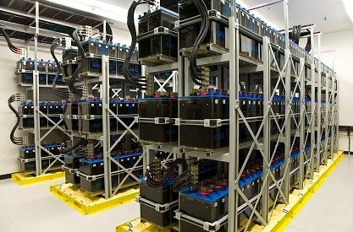
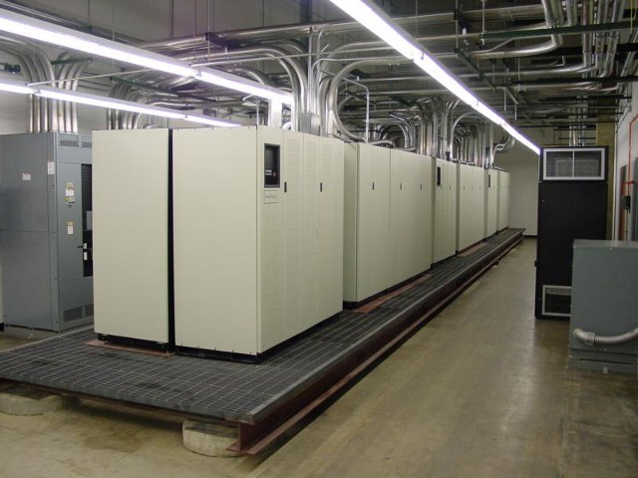
Battery Cabinets
Battery racks
(more common at telco installations)

Slide 17
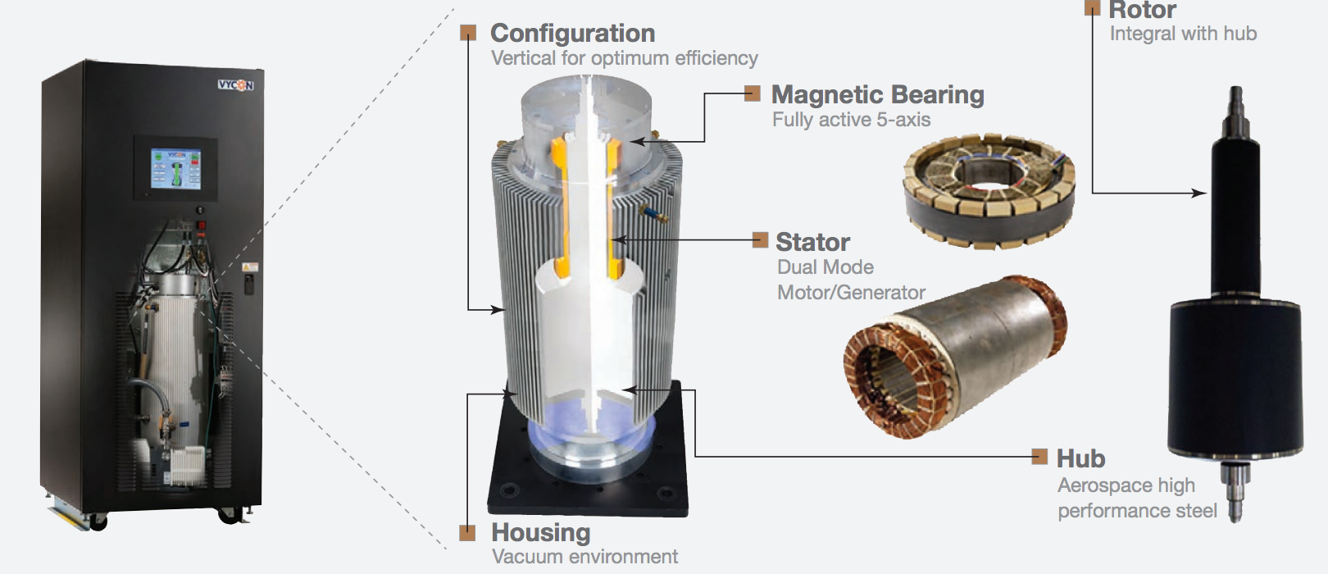
Vycon Flywheel

Slide 18
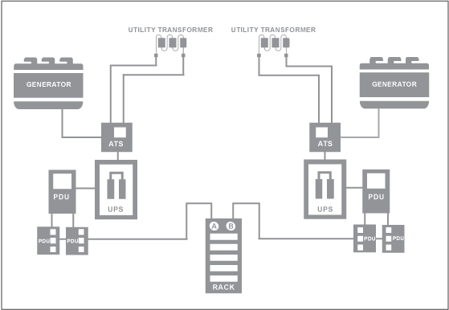
Data Center Power Distribution Diagram

Slide 19
Climate Control System
All IT equipment generates heat.
CPUs, hard drives, power supplies, power transformers, batteries
Climate control has two main concerns:
Regulating both temperature and humidity
Air flow throughout facility

Slide 20
Climate Control
IT equipment is designed to operate within a specific temp/humidity zone.
Traditional: 65-75F (18-24C), Humidity 45-50%
Modern: 75-85F (24-27C)
Low humidity may cause electrostatic discharge and high humidity causes condensation/corrosion
Climate is controlled by circulating cooling agent throughout data center.
Cooling agent (water/glycol) removes heat from air.

Slide 21
Cooling Loop
Pumping station in facility moves cooling agent through loop.
Heat is removed from loop using a chiller and cooling tower.
Coolant passes through Computer Room Air Conditioning Units (CRACs) located throughout server room.
CRACs are similar to your home air conditioners.
Some units also provide humidification.

Slide 22
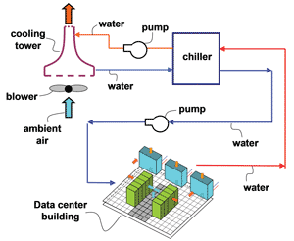
Data Center Cooling Loop Diagram

Slide 23
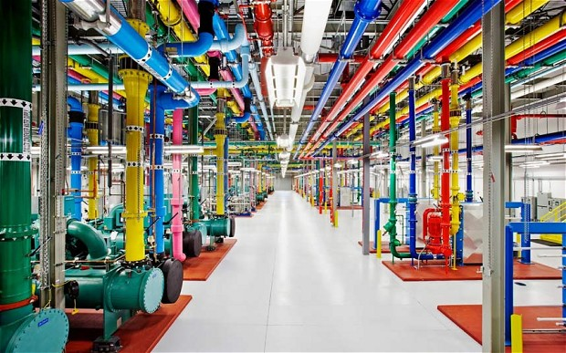
Data Center Chillers

Slide 24
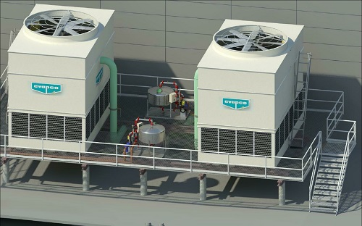
Cooling Towers

Slide 25
Data Center Air Flow
Air flow is one of the biggest concerns in a data center facility.
Heat is generally removed from the air.
High powered or high density equipment can generate hotspots in a server room (example: virtualization/blade systems).
Need to replace hot air with cold air.
Two common server room designs:
Raised-floor facilities
distribute cool air throughout facility using a sub-floor plenum space and perforated floor tiles
Most cabling is located below the tiled floor
Non-raised floor facilities
Air is distributed via duct work
Cabling located on cable ladders and trays above equipment cabinets

Slide 26
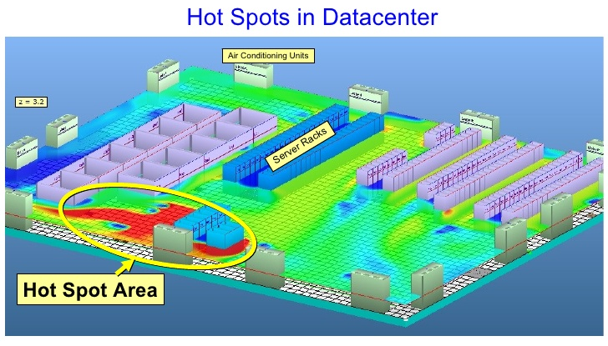

Slide 27
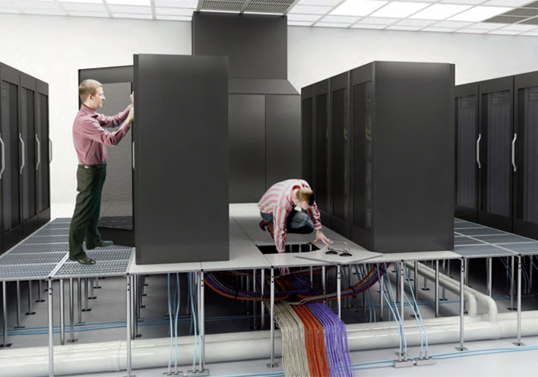

Slide 28
Air Flow Challenges
Biggest challenge is heat containment, trying to maintain separation of hot and cold air.
Mixing air results in decreased cooling performance and higher operating temps.
Solutions:
Hot aisle/Cold aisle configurations
Problem: air can spill over aisles
Chimneys: evacuate hot air from equipment cabinets into ceiling plenum
Hot aisle/Cold aisle containment
Uses curtains, plexiglass partitions, enclosures

Slide 29
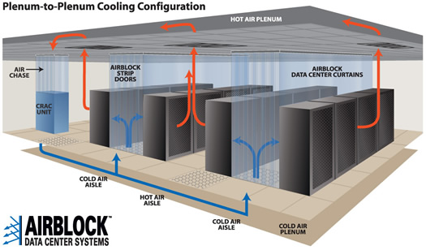

Slide 30
Server Room
This is what most people think of as the “data center”.
Server room houses:
Equipment racks containing IT equipment
Power distribution units
CRAC/ air handling units
UPS systems (sometimes)
The goal is to place as many racks in the server room as feasible
Total # racks and rack density depends on power and cooling
Old datacenters: 1-2KVa/rack
Newer datacenters: 5-20KVa/rack

Slide 31
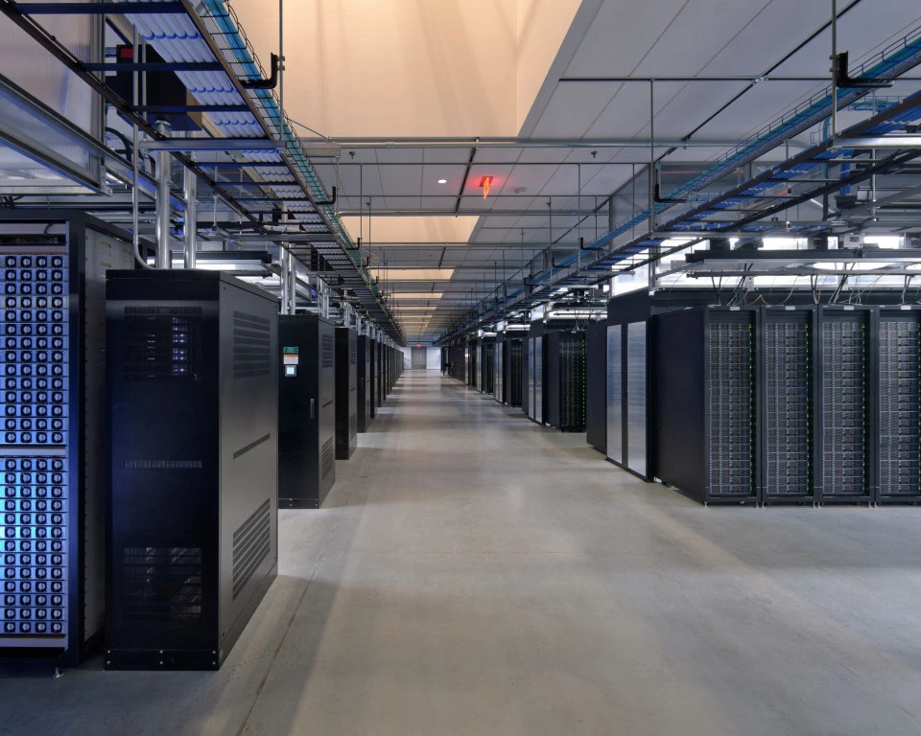
Facebook datacenter (Prineville)

Slide 32
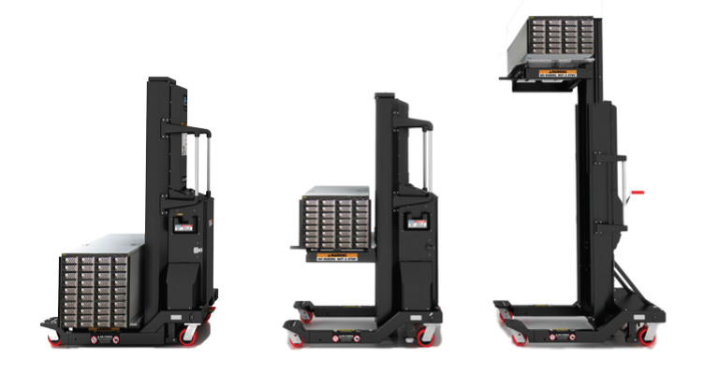
Equipment lift

Slide 33
Network
Data centers usually have multiple network entry points.
Fiber located in trenches connecting data center to local fiber access points.
Network equipment usually in separate room or cage within data center.
Redundant network infrastructure is common.
Core routers/switches route data to top of rack (TOR) switches in server room.

Slide 34
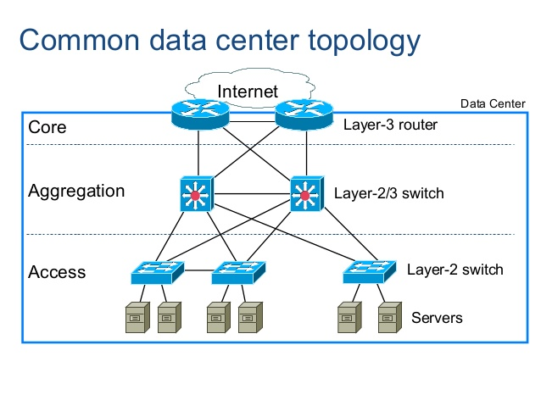

Slide 35
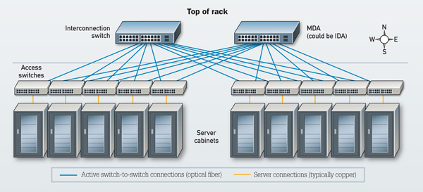

Slide 36
Security System
Data center security is oftentimes the #1 concern of its users.
Security is a combination of tools and practices.
Security is focused on three main areas:
External perimeter of the facility
Internal facility spaces
Organizational security practices

Slide 37
Securing The Perimeter
Property fencing and access gates
Security cameras
Staffed security checkpoint
Locked external access doors with card scanners or biometric readers
Pressure plates on driveways
Metal mesh walls

Slide 38
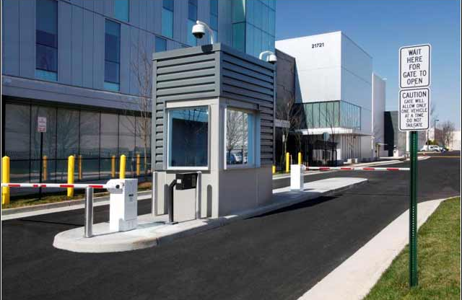
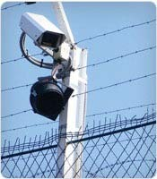
Access checkpoint at
Equinix data center

Slide 39
Internal Security
Security cameras
Security desk
Man trap
Anti-tailgating detection
Motion detectors
Locked equipment cabinets
Biometric readers
Cages

Slide 40
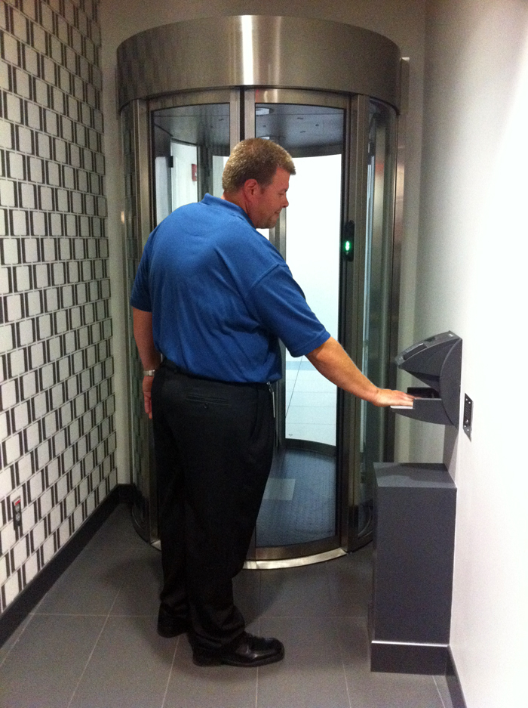
Data center man trap with biometric palm reader

Slide 41
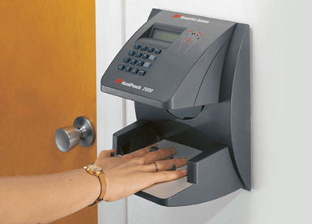

Slide 42
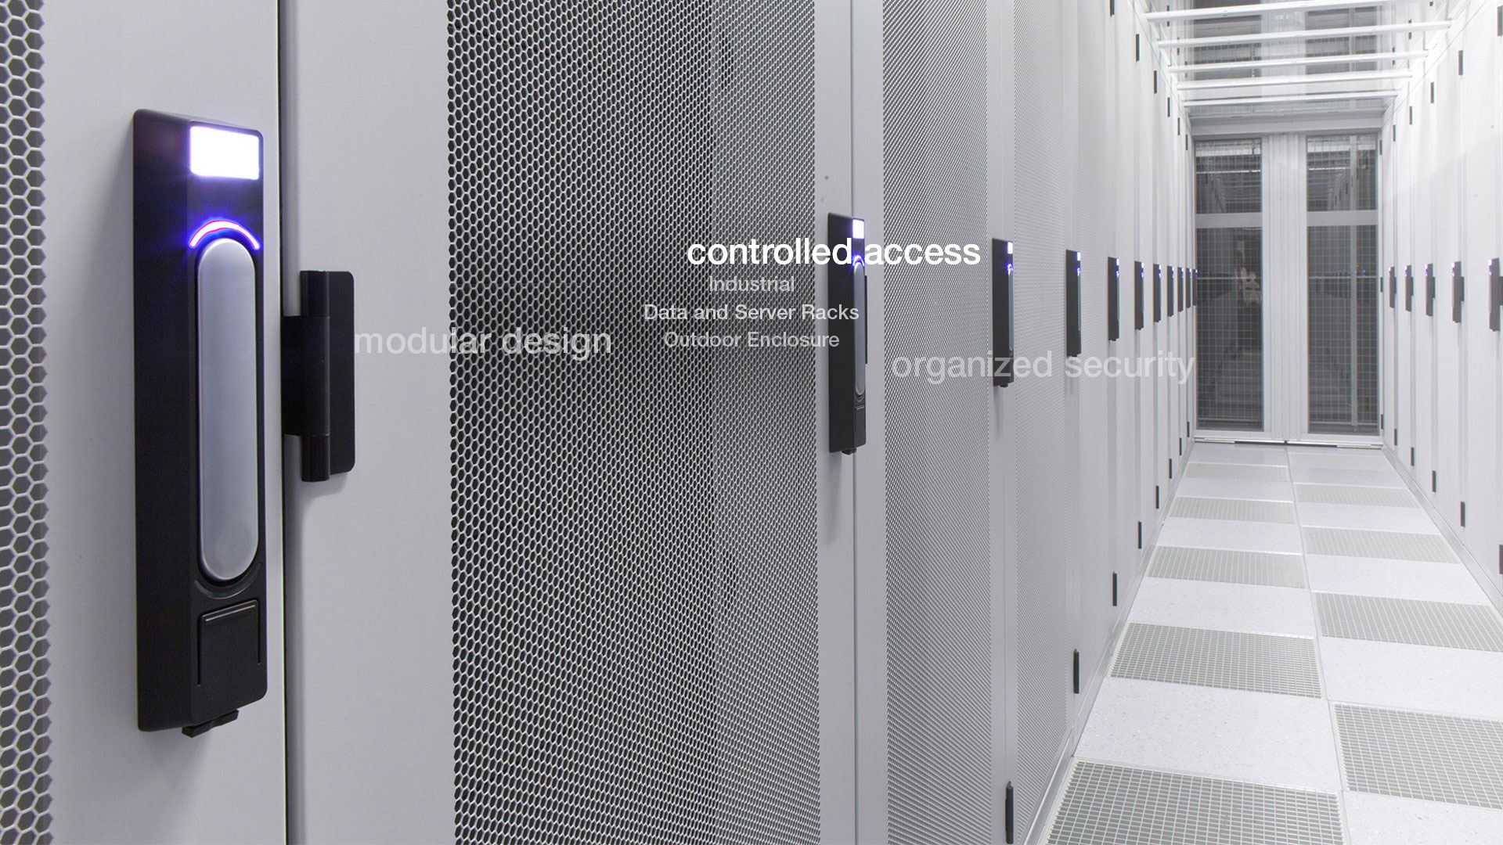

Slide 43
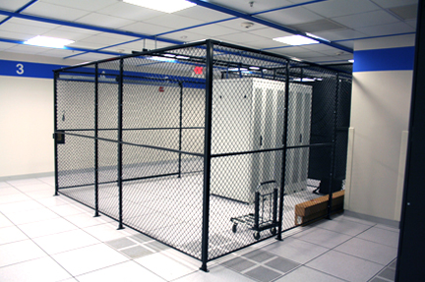

Slide 44
Security Practices
Security patrols
Monitored security cameras and recording
Risk management systems
Security certifications
SOC 1 (SSAE 16), SOC 2, SOC 3
SOC 2 & 3 audit against actual benchmarks
ISO 27001
PCI-DSS (Payment Card Industry Data Security Standard)

Slide 45
Fire Suppression
Fire is a big concern in a data center due to high density of power and heat.
Flammable materials strictly prohibited
Systems unboxed in separate build room
Box dust can trigger smoke detection systems
Very Early Smoke Detection Apparatus (VESDA) detectors
Gaseous fire suppression/ FM200
Dry pipe sprinkler system

Slide 46
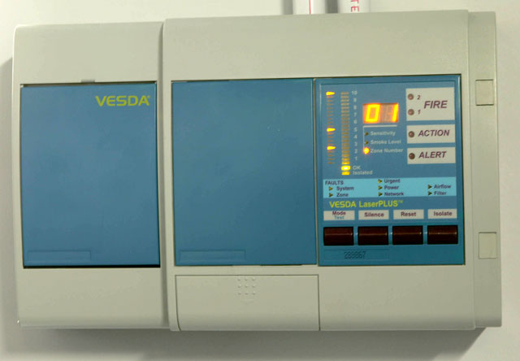
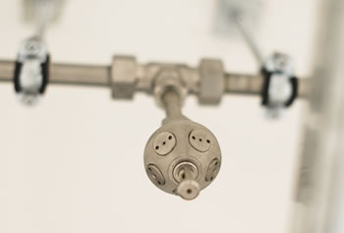
Sprinkler head
VESDA Control Unit

Slide 47
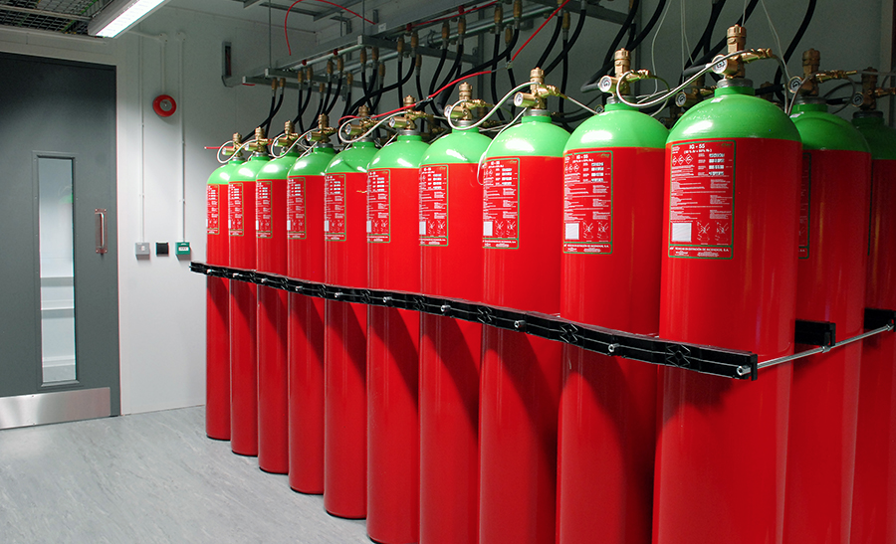
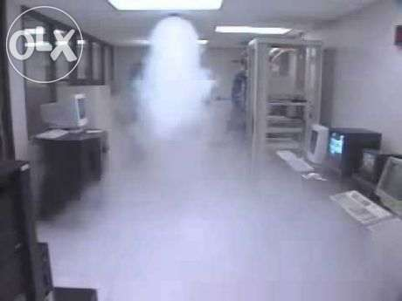
FM200 Tanks

Slide 48
Data Center Efficiency
Data centers are major consumers of power.
Facilities consume more power than many towns.
Power efficiency of a data center is measured by its Power Utilization Effectiveness (PUE).
PUE = Total facility power/ IT equipment power

Slide 49
Data Center Efficiency
Best theoretical PUE is 1.0
Not possible due to power loss in facility
Average PUE ~ 2.0
Large cloud data centers < 1.1
PUE decreases as the utilization of a data center increases.
Example: Data center is using 2MW of power and IT equipment is using 1.25MW. What is the PUE?
Answer: PUE = 2MW/ 1.25MW = 1.6

Slide 50
Data Center Efficiency
Site data center in optimal climate to take advantage of free air cooling.
Outside air needs to be in the right temperature and humidity range much of the year
LEED Certification: facility conforms to “green” specifications and materials.
Renewable power: solar, wind, geothermal, hydroelectric

Slide 51
Data Center Tiers
Tier classification system designed by the Uptime Institute
Tier 1: basic data center with dedicated space for IT systems, UPS, cooling equipment
Tier 2
Some data center components are N+1
Redundant critical power and cooling equipment
Tier 3
All major data center components are N+1
Concurrently maintainable: a redundant delivery path for power and cooling exists to that any component can be serviced without impacting IT operations
Tier 4
All of the above, systems are fault tolerant and failover is automated

Slide 52
Data Center Tiers
Data centers must be audited by the Uptime Institute to receive a tier classification.
Classification doesn’t just cover design
Certification of Design Documents
Certification of Constructed Facility
Certification of Operational Sustainability

Slide 53
Data Center Site Concerns
Extensive studies are done before the location of a future data center is determined
Power and fiber utility access
Zoning to operate generators and industrial equipment
Environmental concerns:
Earth quake fault line
Tornado alley
Flood zone
Airport flight path

Slide 54
Future Data Center Architecture
Future DC designs use more exotic power, cooling methods, and form factors.
PODS: portable data centers built into shipping containers.
Prefabricated with all necessary equipment
Easily transported and moved
Simply connect power, cooling, and network

Slide 55
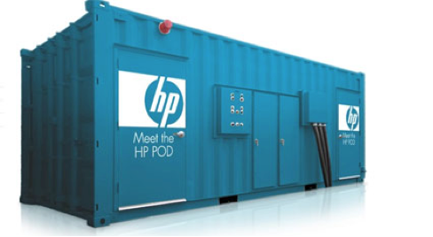
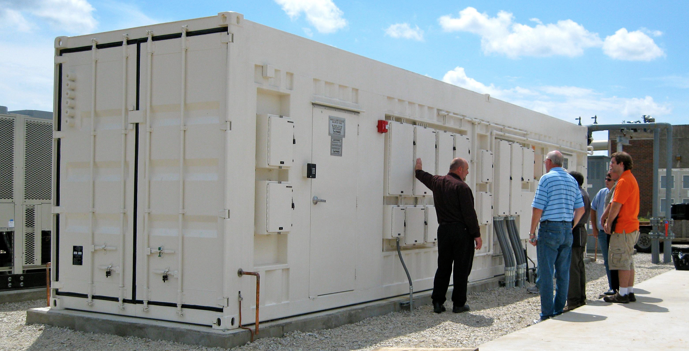
PODS

Slide 56
Micro-data centers
Smaller-scale data centers built in modular fashion from PODs.
Typically unattended facilities in remote locations
Computing/storage allowance designed to handle certain amount of capacity die off.
Microsoft Bing Maps data center

Slide 57
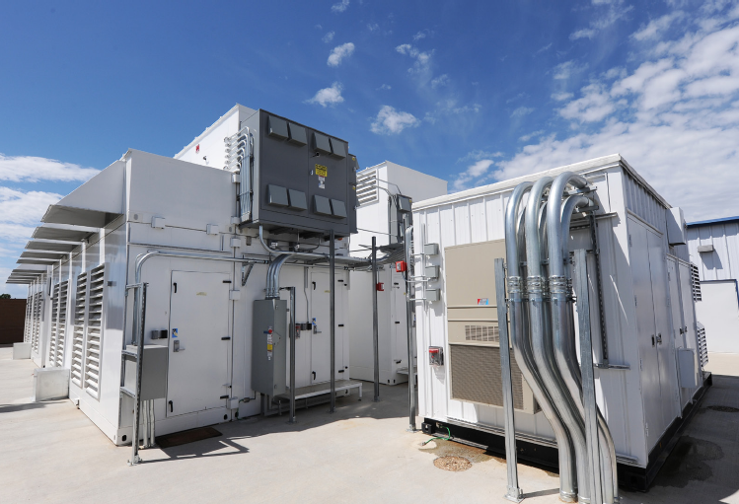

Slide 58
Modular Datacenters
Build a data center shell with all supporting power and cooling equipment.
Place compute and storage containers into the shell.
Replace containers periodically to upgrade capacity.
Microsoft Chicago/ Azure facility

Slide 59
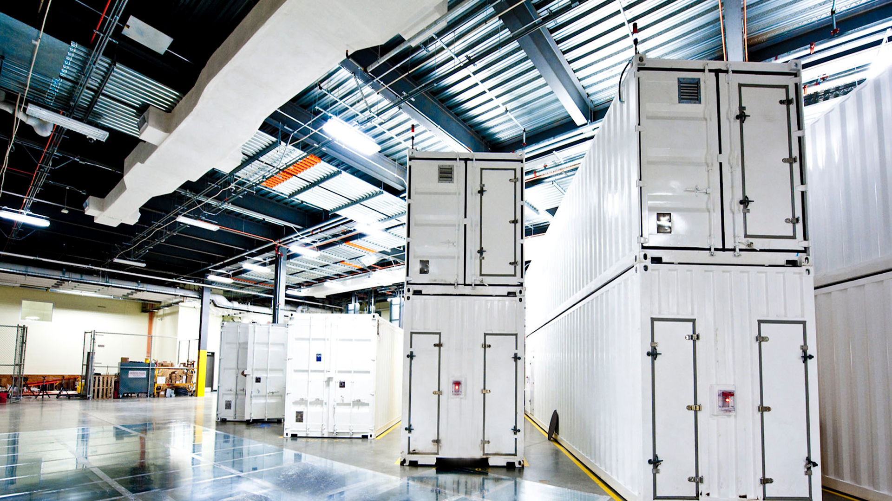

Slide 60
Facebook Prineville
Innovative cooling system utilizing outside air, filtration, and evaporative spray system.
Facebook started the Open Compute Project to encourage sharing innovative data center and systems designs.
Large cloud providers build their own equipment

Slide 61
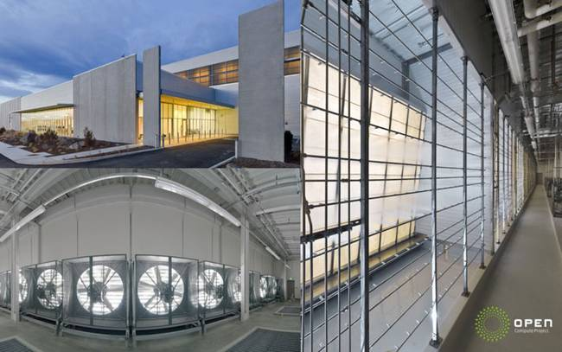

Slide 62
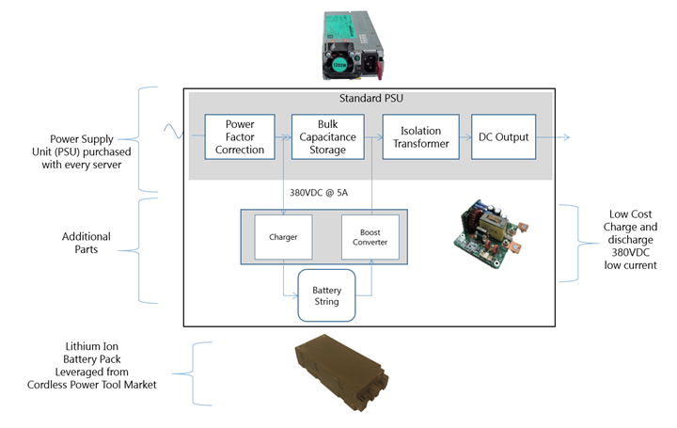
Microsoft LES eliminates UPS by combining computer power supply and battery

Slide 63
Homework
No homework this week.
Good luck on the final exam!

